Slide 1
Enhancing the Variable Infiltration Capacity Model to Account for Natural and Anthropogenic Impacts on Evapotranspiration in the North American Monsoon Region
Theodore J. Bohn and Enrique R. Vivoni, Arizona State University
NLDAS Monthly Telecon, Feb 17, 2016

Slide 2
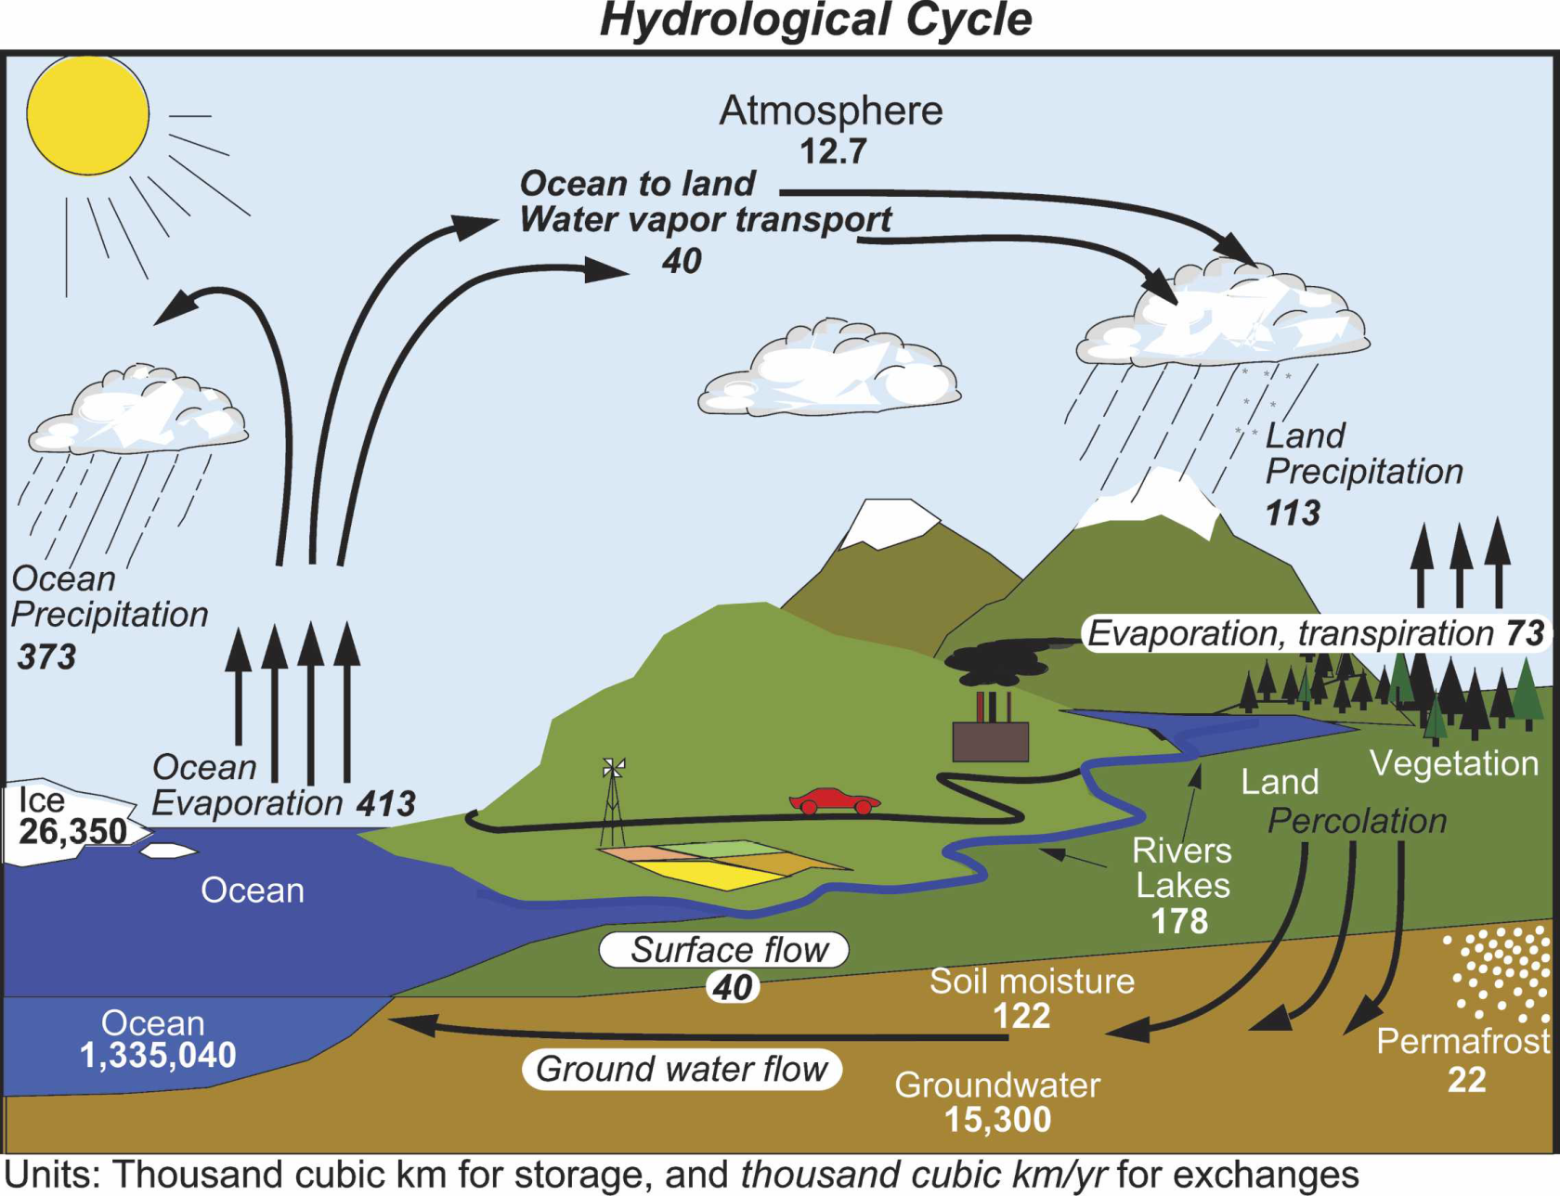
Importance of Accurate ET in Land Surface Models
2nd largest term in terrestrial water budget
Arid regions: ET ≈90% of P
Least-constrained by observations
Errors in ET cause errors in Q ( ≈ P – ET)
Errors impact estimates of ET-P feedbacks
Trenberth et al. (2007)

Slide 3
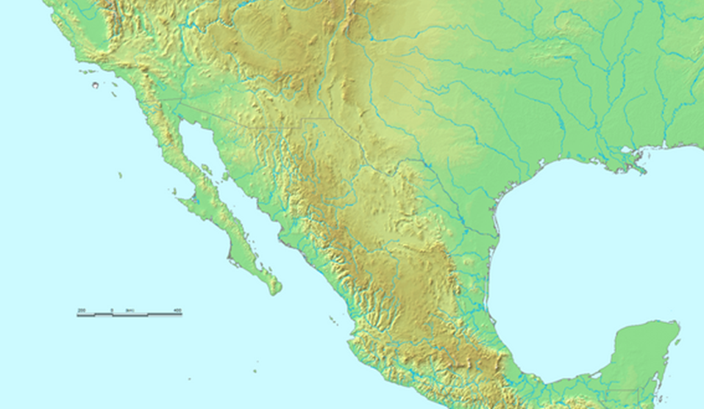
North American Monsoon (NAM)
Summer monsoon provides >50% of annual rainfall here
ET
Pacific
Ocean
P
Gulf of
Mexico
Surge
40% P-recycling
Monsoon highly variable
LSMs disagree on ET here
Could better ET improve forecasts?
Tropical Moisture

Slide 4
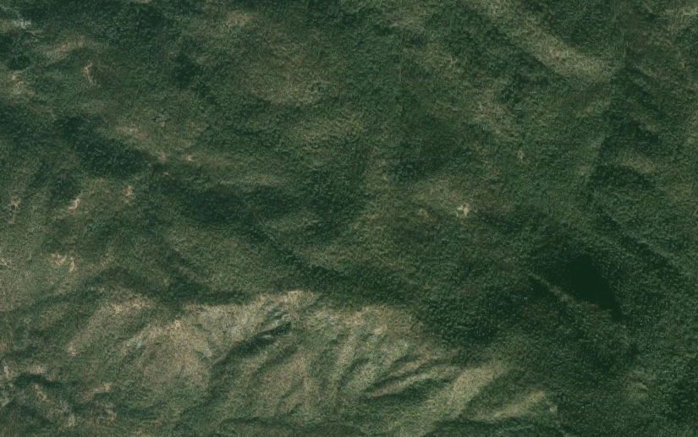
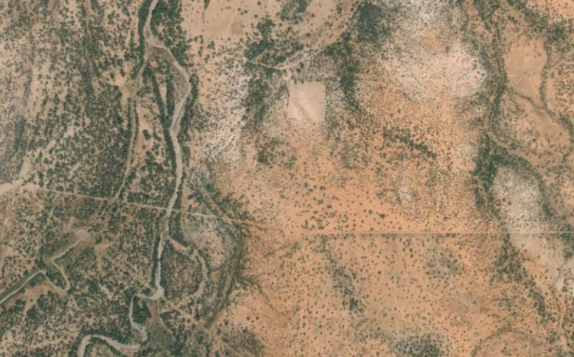
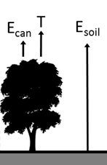
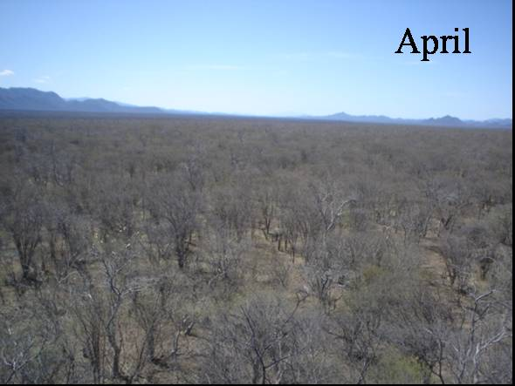
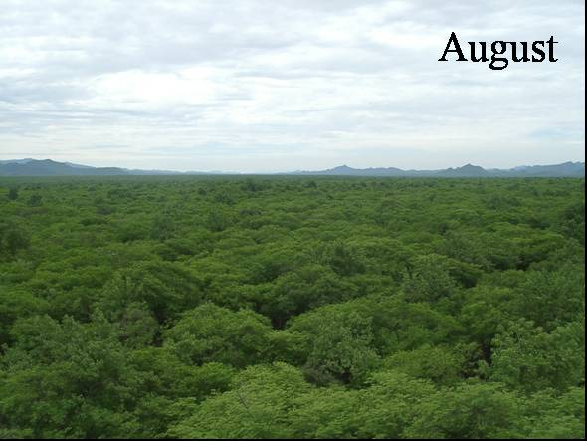
ET Partitioning
Open Shrublands
Forests
200 m

Slide 5
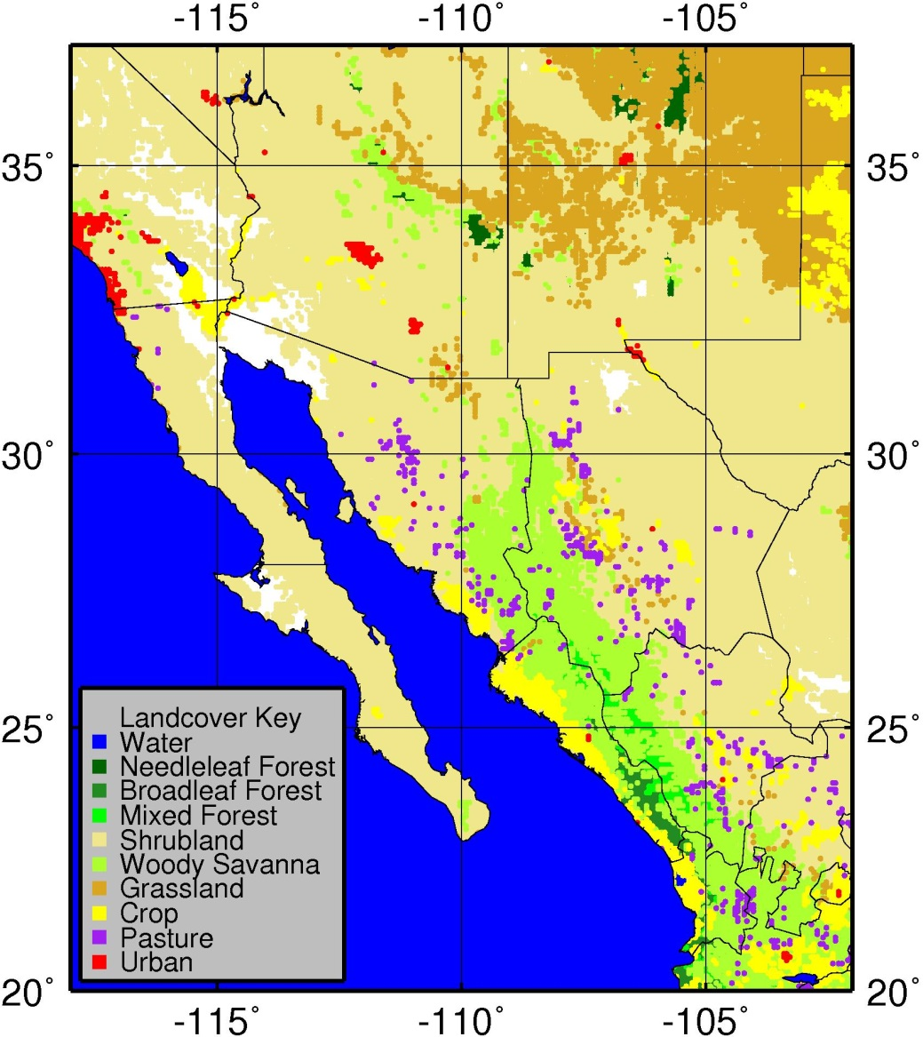
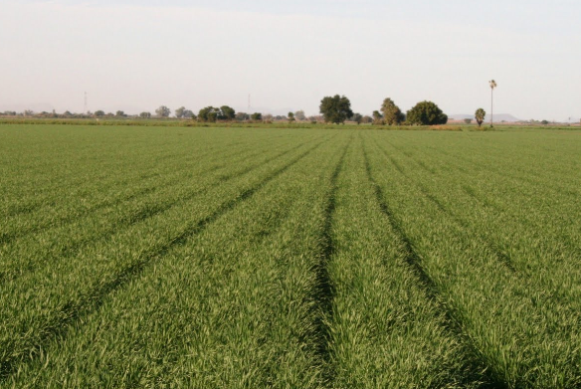
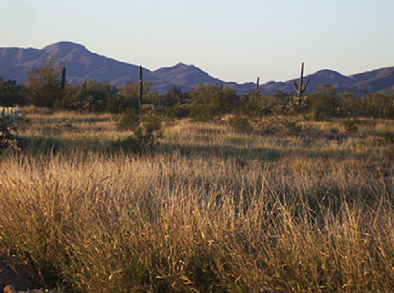
Land Cover/Land Use Change
Deforestation / Pasture Clearing
>10,000 km² in NAM region
Most of it since 1970s
Irrigated Agriculture
Both winter and summer crops
7% of land area
Ignored in large-scale studies

Slide 6
Science Questions
What are the major sources of ET in the NAM region?
How do they vary in time/space?
What are the major underlying mechanisms?
Bohn, T. J., and E. R. Vivoni, 2016: A Process-Based Characterization of Evapotranspiration Sources in the North American Monsoon Region, WRR, 52(1), 358-384, doi: 10.1002/2015WR017934.

Slide 7
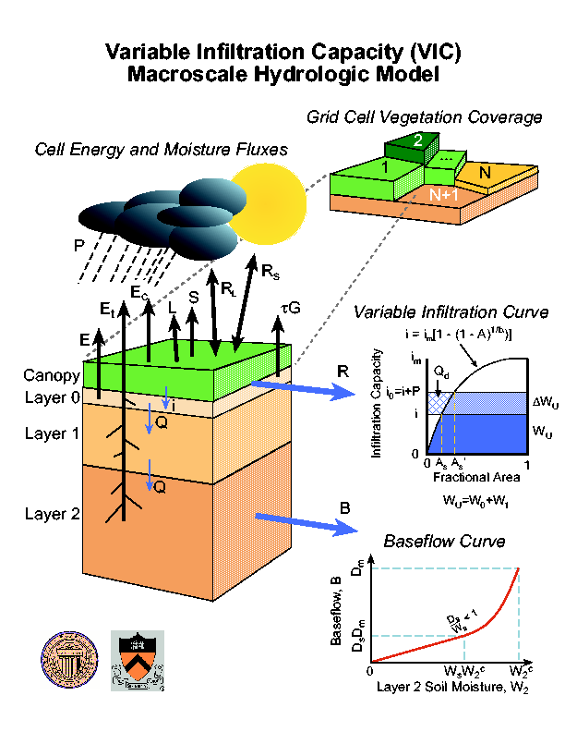
VIC Land Surface Model
VIC 4.2
Large-scale hydrology model (Liang et al., 1994)
1/16 degree spatial resolution
Hourly time step
Solves moisture and energy balances
Mosaic of land cover “tiles”
Calibrated over Mexico by Zhu et al. (2007)
Liang, X., et al., 1994: A simple, hydrologically based model of land surface water and energy fluxes for GSMs, J. Geophys. Res., 99(D7), 14415-14428.
Zhu, C., et al., 2007: Role of antecedent land surface conditions in warm season precipitation over northwestern Mexico, J. Climate, 20, 1774-1791.

Slide 8
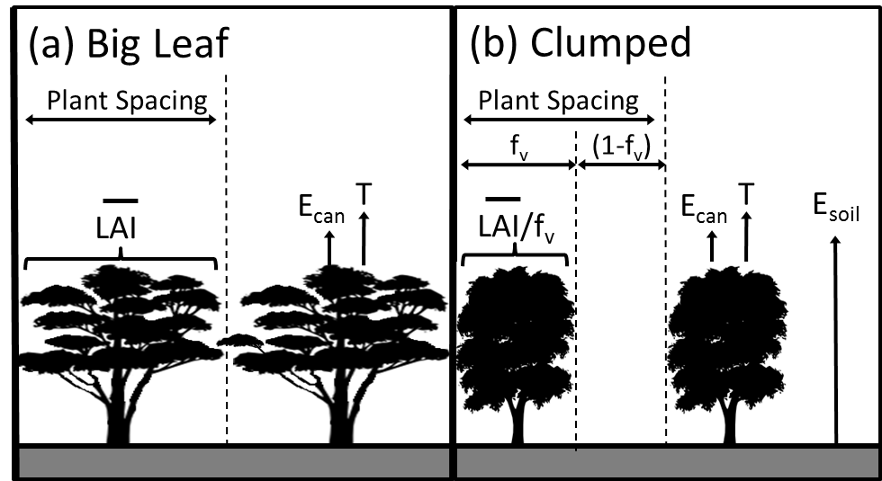
VIC Modifications
Implement clumped vegetation scheme
Allows evaporation from exposed soil between plants
Veg canopy cover fraction f_{v} derived from NDVI
E_{soil} taken from ARNO model (Francini and Pacciani 1991)
Bohn and Vivoni, WRR (2016)
Francini and Pacciani., 1991: Comparative analysis of several conceptual rainfall-runoff models, J. Hydrol., 122, 161-219.

Slide 9
VIC Modifications
Read time series of vegetation characteristics (2000-2012) as forcing variables:
NDVI: MODIS 16-day 500m
LAI: MODIS 8-day 1000m
Albedo: MODIS 16-day 500m
Irrigation
Scheme of Haddeland et al. (2006)
Crop/Fallow Fraction derived from MODIS reflectances (Lobell and Asner, 2004)
Haddeland, I., et al., 2006: Effects of irrigation on the water and energy balances of the Colorado and Mekong river basins, J. Hydrol., 324(1), 210-223.
Lobell and Asner, 2004: Cropland distributions from temporal unmixing of MODIS data, Rem. Sens. Env., 93(3), 412-422.

Slide 10
PVI-Crop Area Relationship
Winter
Summer

Slide 11
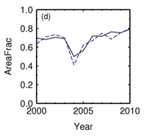
Timeseries of Crop Areas
RCO
COM
Areas are expressed as fractions of total MODIS crop pixel area within each region
Method reproduces Yaqui Valley shortage in 2004-2005
BCS_S
SON_S
SIN
CHI_NWC

Slide 12
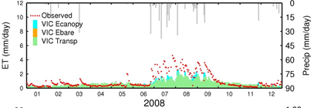
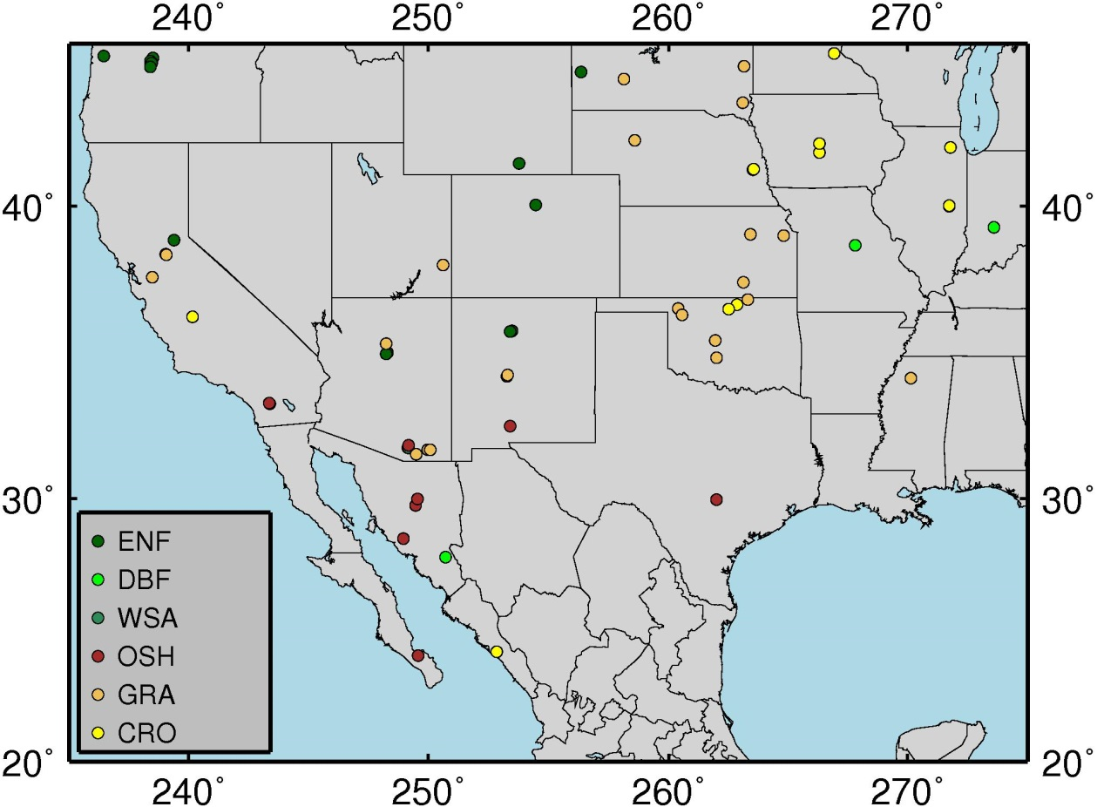
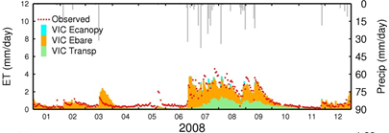
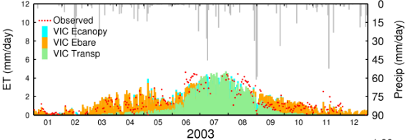
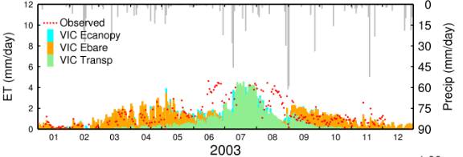
Model Validation: Eddy Covariance Towers
Big Leaf
Clumped
BO1
SRM
Irrigation=TRUE
Irrigation=FALSE

Slide 13
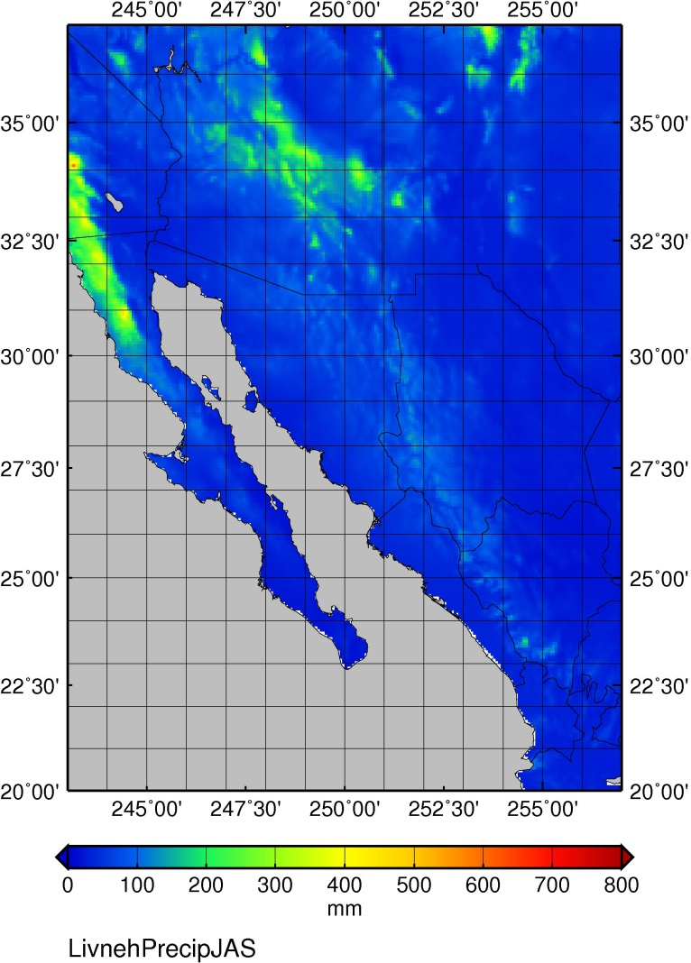
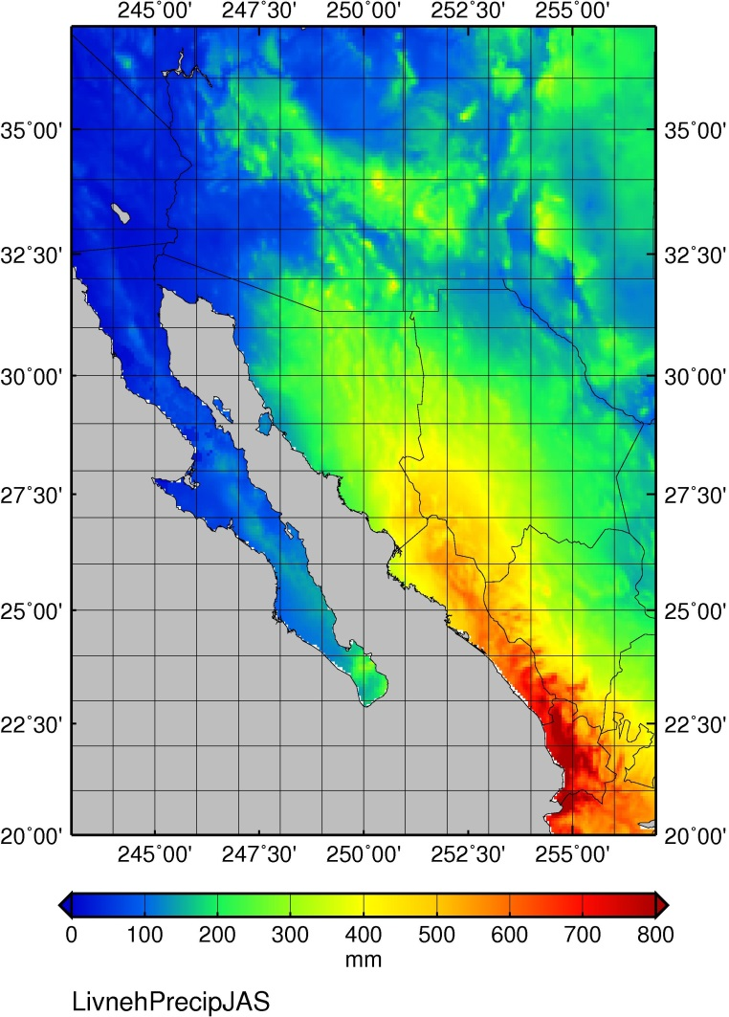
Gridded Meteorological Inputs
Livneh et al (2015)
Met. Station Data covering 1950-2013:
5000 SMN station observations across Mexico
20000 COOP stations across USA
Daily Fields:
Total precipitation
Max/min air temperatures
Average wind speed
1/16 degree resolution
Elevation correction
JFM Precip, 2000-2012
JAS Precip, 2000-2012
Livneh, B., et al., 2015: A spatially comprehensive hydrometeorological data set for Mexico, the U.S., and southern Canada 1950-2013, Nature Scientific Data, 2, 150042, doi: 10.1038/sdata.2015.42.

Slide 14
VIC ET, 2000-2012
Annual
Winter
Summer
Largest fluxes: mountain forests and irrigated agriculture
22% and 9% of ET by volume

Slide 15
Comparison with Other Products
Remote Sensing – Penman-Monteith (RS-PM)
No soil model
Soil moisture related to air humidity
Process-based models
None of these handle irrigation
Product | Type | Comment
Mu et al (2011) | RS-PM | Exposed soil area related to FPAR
Sheffield et al (2010) | RS-PM | Big Leaf Formulation
North American Regional Reanalysis (NARR) | Coupled land-atmosphere model; assimilates met. | Over Mexico, P has no elevation correction
North American Land Data Assimilation (NLDAS) | Offline LSMs driven by common met. forcings | Over Mexico, P has no elevation correction
VIC 4.0.3 | LSM | Big Leaf Formulation
NOAH | LSM
MOSAIC | LSM

Slide 16
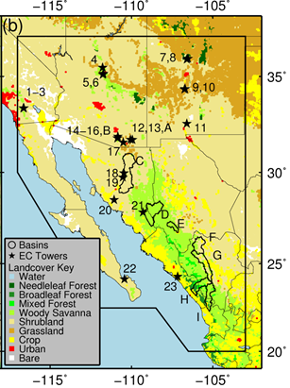
Small Basin ET/P Ratios
ET_{obs} = P_{obs} – Q_{obs}
P_{obs} = P used by model
Product | Mean ET/P | Bias
Obs | 0.86 | 0.00
VIC | 0.85 | -0.01
Mu et al 2011 | 0.67 | -0.19
Sheffield et al 2015 | 0.56 | -0.30
NARR | 0.71 | -0.15
NLDAS-VIC | 0.80 | -0.06
NLDAS-NOAH | 0.87 | +0.01
NLDAS-MOSAIC | 0.95 | +0.09

Slide 17
Other Gridded ET Products, 2000-2012
Mu et al (2011) lacks ET over deserts
Sheffield et al (2010) underestimates ET almost everywhere
NARR and NLDAS
Discontinuity at US-Mexico border
Underestimate ET over SMO
All products underestimate ET over croplands

Slide 18
Annual ET Partitioning
VIC partitioning over whole domain:
Esoil = 60%
Transp = 32%
Ecan = 8%
NLDAS-VIC has zero Esoil almost everywhere (except over pure bare soil pixels)
VIC, NLDAS-NOAH, and NLDAS-MOSAIC agree:
Shrublands: Esoil = 35-100 %
Forests: Esoil = 5-35 %

Slide 19
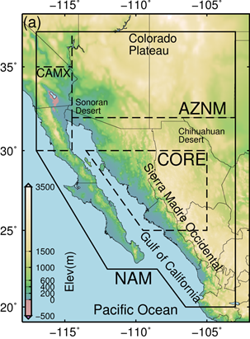
Seasonal Cycle
AZNM
CAMX
CORE
ET peaks in August everywhere except CAMX
Smaller March peak in CAMX and AZNM
Mu et al (2011) lacks summer ET in AZNM
NARR and NLDAS-VIC overestimate late spring ET in AZNM
NLDAS-VIC underestimates winter ET in AZNM
NLDAS-VIC attributes all ET to Transp.

Slide 20
Temporal Response of Land Cover
Correlations between Fluxes and Precipitation
Flux | Annual P | Same Season P |  |  |  | Previous Season P
 |  | JFM | AMJ | JAS | OND | JFM | AMJ | JAS | OND
P | 1.0 | 1.0 | 1.0 | 1.0 | 1.0 | 0.69 | 0.06 | -0.13 | -0.20
ET | 0.90 | 0.96 | 0.88 | 0.93 | 0.92 | 0.72 | 0.47 | 0.05 | 0.10
Esoil | 0.81 | 0.95 | 0.95 | 0.84 | 0.96 | 0.68 | 0.17 | -0.16 | -0.20
T | 0.68 | 0.76 | 0.18 | 0.68 | -0.07 | 0.67 | 0.89 | 0.22 | 0.79
Yellow = statistically significant
Esoil controlled by current season’s P
Transpiration controlled by previous season’s P
Shrublands
Forests
Crop ET has essentially ZERO correlation with P

Slide 21
Conclusions
Model Performance
New VIC performs well at eddy covariance towers
New VIC outperforms most other available products over NAM region
ET/P
Irrigated croplands
Mu et al (2011) and Sheffield et al (2010) substantially underestimate ET in the NAM region
Lack soil moisture model
Underestimate Esoil

Slide 22
Conclusions
ET Sources
Mountain forests and irrigated agriculture are strongest sources of ET in the NAM region
22% and 9% of ET by volume
ET Partitioning
Primary ET component = Esoil (60%)
Desert Shrublands = Esoil
Mountain Forests = Transp.
ET-P relationships
Esoil (shrublands) controlled by current season’s P
Transp (forests) controlled by previous season’s P
ET over irrigated croplands is not controlled by P
Implications for P-recycling and forecast skill?

Slide 23
Future Work
Currently working on incorporating VIC into WRF-Hydro (collaboration with Bart Nijssen at UW)
Examine impacts of land cover/use change on ET-P coupling in NAM region

Slide 24
Thank You
T. Bohn is supported by Grant 1216037 from the U.S. National Science Foundation (NSF) Science, Engineering and Education for Sustainability (SEES) Post-Doctoral Fellowship program.
This material is based upon work supported by the National Science Foundation under Grant SES-0951366, Decision Center for a Desert City II: Urban Climate Adaptation.
Bohn, T. J., and E. R. Vivoni, 2015: A Process-Based Characterization of Evapotranspiration Sources in the North American Monsoon Region, Water Resources Research (in review).

Slide 25
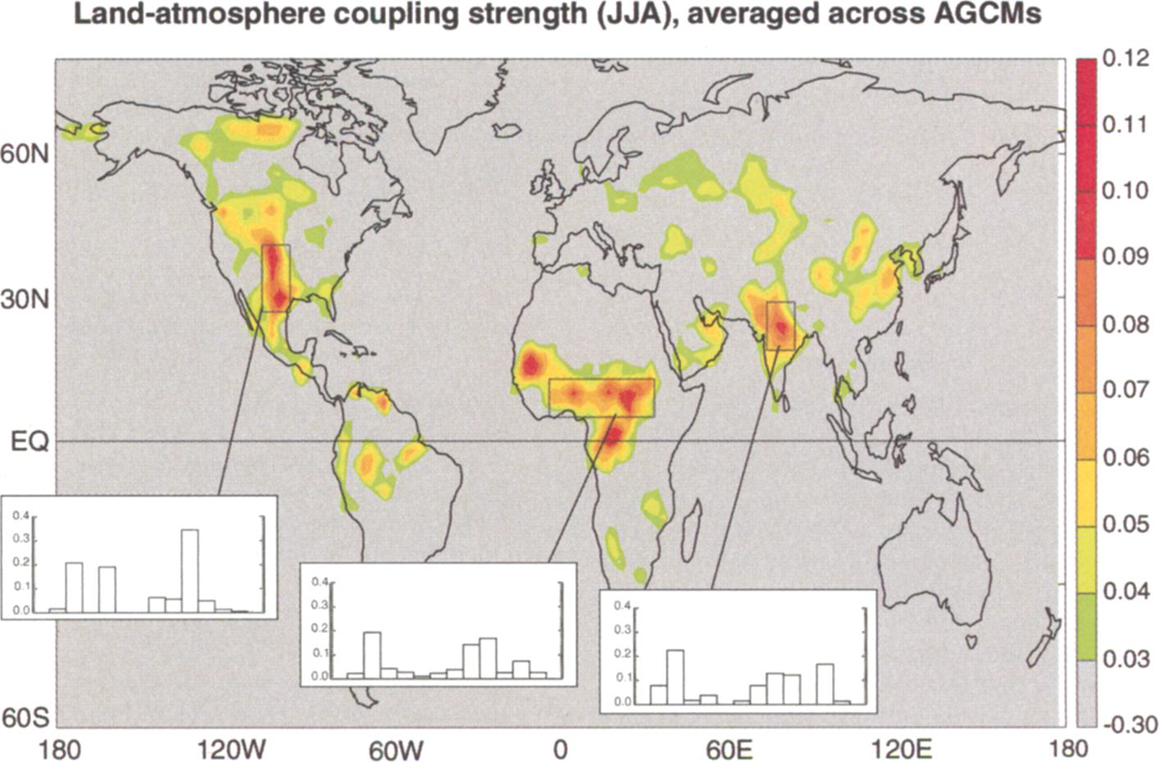
Land-Atmosphere Coupling (ET-P)
North American Monsoon (NAM) Region
Great Plains
Higher-resolution studies: 40% P-recycling in the NAM region (Hu and Dominguez, 2015)
GLACE - Koster et al. (2004)

Slide 26
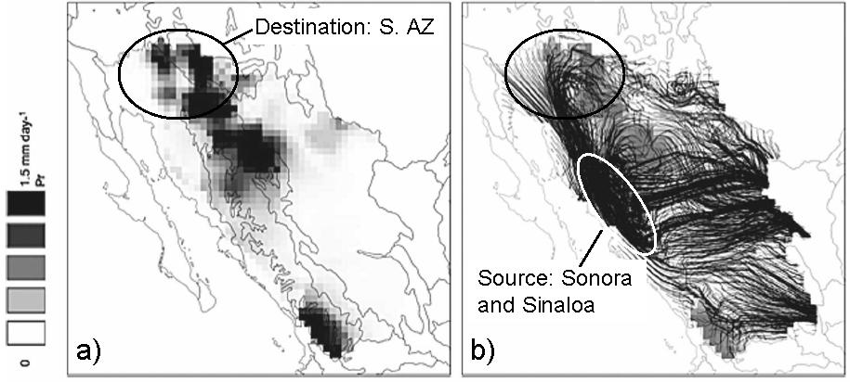
Moisture Transport in Monsoon
Dominguez et al (2008) analyzed monsoon moisture transport, using NARR + analytical model
Recycling ratios of up to 25%
Precipitation
Moisture Flow Paths
Dominguez, F., et al., 2008: Precipitation recycling variability and ecoclimatological stability – a study using NARR data. Part II: North American Monsoon region, J. Climate, 21, 5187-5203, doi: 10.1175/2008JCLI1760.1.

Slide 27
Performance Statistics
Plant Functional Type (PFT) | N | $\overline{Bias}$ (mm d⁻¹) | JJA $\overline{Bias}$ [mm d⁻¹] (%) | $$\overline{r}$$ | $\overline{RMSE}$ (mm d⁻¹) | Median NSE
ENF | 8 | -0.1050 | -0.0421 (-2) | 0.7282 | 0.7872 | 0.4947
DBF | 2 | -0.0671 | -0.2151 (-7) | 0.7246 | 1.2126 | 0.6351
WSA | 2 | -0.0125 | -0.1639 (-7) | 0.7828 | 0.8419 | 0.3806
SAV | 1 | 0.1533 | -0.0972 (-10) | 0.7716 | 0.7800 | 0.5651
CSH | 4 | -0.2680 | -0.3641 (-27) | 0.6461 | 0.6610 | 0.1450
OSH | 8 | -0.1115 | -0.1115 (-14) | 0.7397 | 0.6234 | 0.5305
GRA | 21 | -0.0091 | -0.1028 (-10) | 0.7824 | 0.8542 | 0.5331
CRO – Irrigated Maize/Soy | 6 | -0.0062 | 0.0717 (3) | 0.8476 | 0.8022 | 0.6979
CRO – Rainfed Maize/Soy | 1 | 0.0511 | -0.1682 (-6) | 0.5793 | 1.1252 | 0.2911
CRO – Rainfed Wheat | 1 | -0.0400 | 0.1352 (7) | 0.7478 | 0.7500 | 0.4910
CRO – Irrigated Orchard | 1 | 0.2812 | 0.2417 (12) | 0.6870 | 0.6911 | 0.0836
CRO – Irrigated Maize/beans with 35% crop cover | 1 | 0.2533 | 0.3527 (12) | 0.8060 | 0.6999 | 0.5955

